Slide 1

Corona Virus Analysis
@Mentorness

Slide 2

Introduction:
The COVID-19 pandemic has had a profound impact on global health, economies, and societies. As data analysts, we can leverage SQL (Structured Query Language) to explore and gain insights from COVID-19 data. In this project, we’ll focus on using SQL to query and analyze relevant datasets.

Slide 3
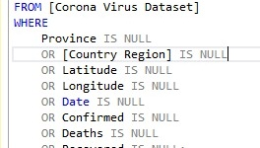
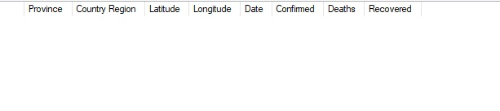
Checking for null values
Output:

Slide 4
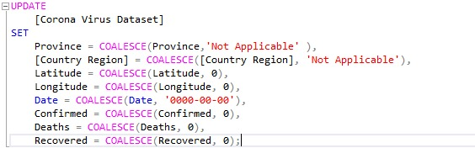
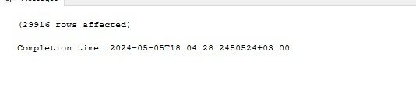
Updating null values if present
Output:

Slide 5

Total number of rows
Output:

Slide 6


Finding the start and end date
Output:

Slide 7

Total number of months
Output:

Slide 8
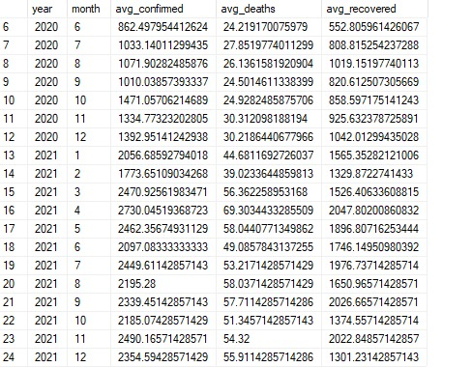
Average of Confirmed,Deaths,and Recovered
Output:

Slide 9
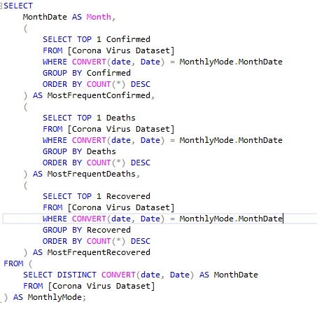
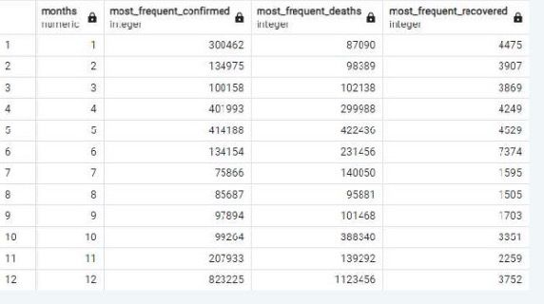
Most frequent value of Confirmed,Deaths,and Recovered
Output:

Slide 10
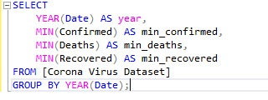

Minimum of Confirmed,Deaths,and Recovered
Output:

Slide 11
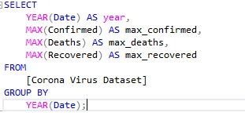

Maximum of Confirmed,Deaths,and Recovered
Output:

Slide 12
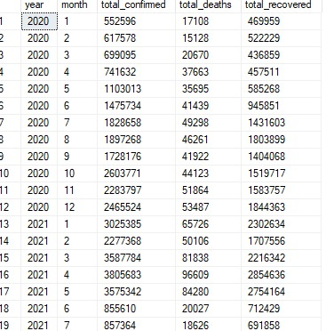
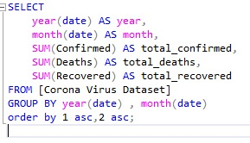
Monthly Total of Confirmed,Deaths,and Recovered
Output:

Slide 13
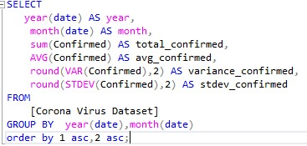
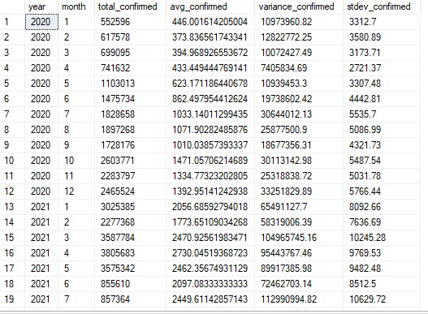
Spread of Corona Virus with Respect to Confirmed Case
Output:

Slide 14
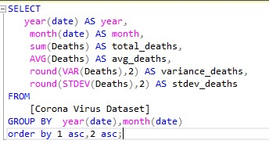
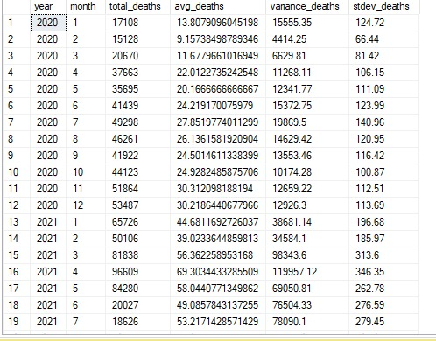
Spread of Corona Virus with Respect to Death Case
Output:

Slide 15
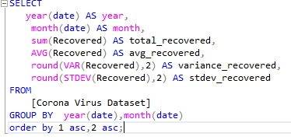
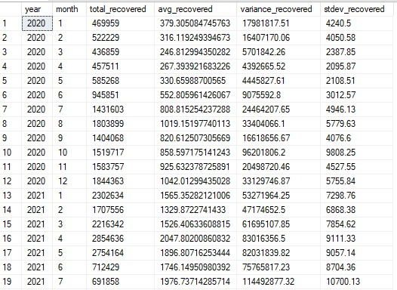
Spread of Corona Virus with Respect to Recovered Case
Output:

Slide 16


Country with the Most Confirmed Cases
Output:

Slide 17


Country with the Least Death Cases
Output:

Slide 18

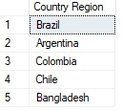
Top 5 Countries by Recovered Cases
Output:

